Slide 1


Himanshu Omprakash Pathak
28th December 2023

Slide 2

Outline
Executive Summary
Introduction
Methodology
Results
Conclusion
Appendix

Slide 3
Executive Summary
Summary of methodologies
-Data Collection with API
-Data Collection with help of Web Scraping
-Data Wrangling
-Exploratory Data Analysis through SQL
-Exploratory Data Analysis & Data Visualization
-Interactive Visual Analytics with Folium
-Machine Learning & Prediction
Summary of all results
-Result of Exploratory Data Analysis
- screenshots of Interactive analytics
- Results of Predictive Analytics

Slide 4
Introduction
Project background and context
Space X promotes Falcon 9 rocket launches on its website, pricing them at 62 million dollars. In contrast, other providers charge upwards of 165 million dollars for each launch. A significant portion of the cost savings stems from Space X's ability to reuse the first stage. Consequently, if we can ascertain whether the first stage will successfully land, we can estimate the overall launch cost. This information becomes valuable when another company seeks to bid against Space X for a rocket launch. The primary objective of this project is to establish a machine learning pipeline to predict the successful landing of the first stage.
Problems you want to find answers
What contributes to the successful landing of a rocket?
The interplay of different factors that influence the success rate of a landing.
What operational conditions must be established to guarantee a successful landing program?

Slide 5

Section 1

Slide 6
Methodology
Executive Summary
Data collection methodology:
Describe how data was collected
Perform data wrangling
Describe how data was processed
Perform exploratory data analysis (EDA) using visualization and SQL
Perform interactive visual analytics using Folium and Plotly Dash
Perform predictive analysis using classification models
How to build, tune, evaluate classification models

Slide 7
Data Collection
The data acquisition involved diverse methodologies:
The SpaceX API was queried through a GET request to collect data.
Subsequently, the response content was decoded as JSON using the json() function and transformed into a Pandas dataframe using json_normalize.
Data cleaning followed, including the identification and handling of missing values.
Additionally, web scraping from Wikipedia was conducted to obtain Falcon 9 launch records, utilizing BeautifulSoup.
The aim was to extract launch records from an HTML table, parse the table, and convert it into a Pandas dataframe for subsequent analysis.

Slide 8
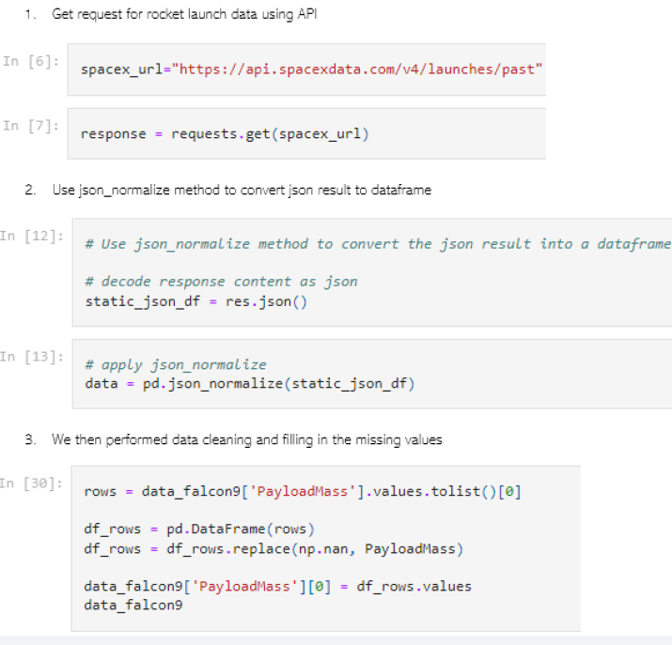
Data Collection – SpaceX API
We employed a GET request to the SpaceX API for data collection, where we processed the retrieved data, performed basic data wrangling, and applied necessary formatting.
The Github link to the notebook is
https://github.com/himanshupathakk/IBM-Data-Science-Capstone/blob/e5bd460d1947cb46d5753278aa282e9ed762aa4e/Web%20scraping%20Falcon%209%20and%20Falcon%20Heavy%20Launches%20Records%20from%20Wikipedia%201st.ipynb
Place your flowchart of SpaceX API calls here

Slide 9
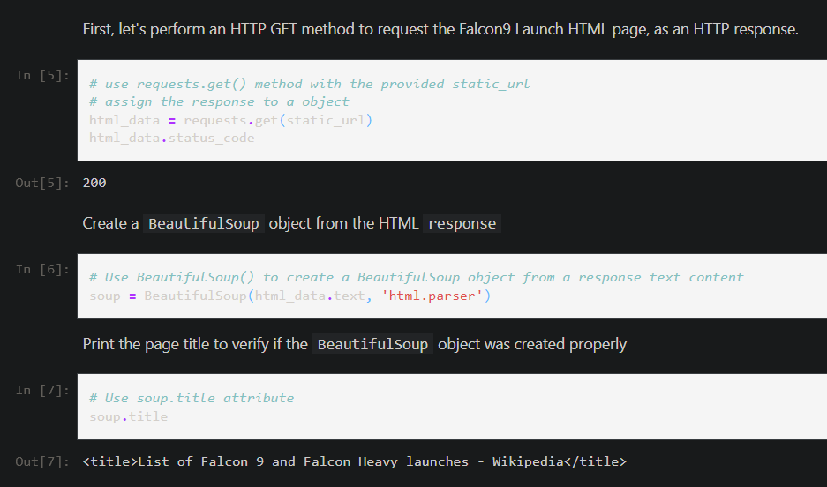
Data Collection - Scraping
We utilized web scraping with BeautifulSoup to extract Falcon 9 launch records from a webpage.
Following this, we parsed the table and transformed it into a Pandas dataframe.
Add the GitHub URL
https://github.com/himanshupathakk/IBM-Data-Science-Capstone/blob/e5bd460d1947cb46d5753278aa282e9ed762aa4e/Web%20scraping%20Falcon%209%20and%20Falcon%20Heavy%20Launches%20Records%20from%20Wikipedia%201st.ipynb
Place your flowchart of web scraping here

Slide 10
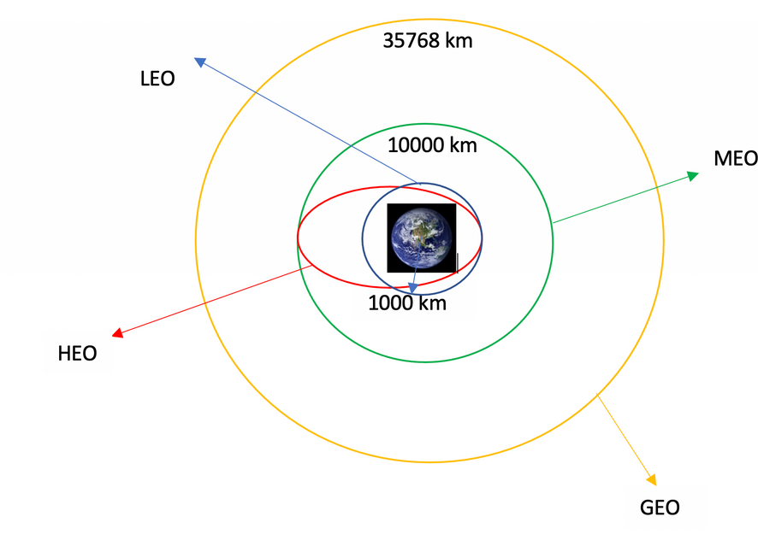
Data Wrangling
We conducted exploratory data analysis to establish the training labels.
This involved computing the count of launches at each site, as well as the frequency and occurrence of each orbit. Additionally.
we derived landing outcome labels from the outcome column and exported the results to a CSV file.
The link to the notebook is
https://github.com/himanshupathakk/IBM-Data-Science-Capstone/blob/eaa3e193ead21bf157c2b711d4c7fbabad0caa33/Spacex-Data%20wrangling%20ii.ipynb

Slide 11
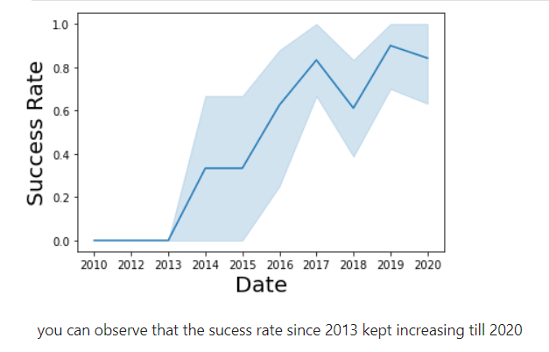
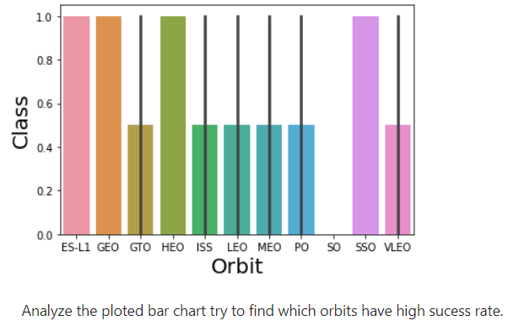
EDA with Data Visualization
We delved into the data by creating visualizations to examine the correlation between flight number and launch site, payload and launch site, success rate for each orbit type, flight number and orbit type, and the yearly trend in launch success.
The link to the notebook - https://github.com/himanshupathakk/IBM-Data-Science-Capstone/blob/d32e42cc6fd71f81f983bb00092b971338d1b0d4/EDA%20with%20Visualization%20lab.ipynb

Slide 12
EDA with SQL
We seamlessly imported the SpaceX dataset into a PostgreSQL database directly within the Jupyter notebook. Subsequently, we employed exploratory data analysis (EDA) with SQL to extract insights from the data. Specific queries were written to discover information such as:
The names of unique launch sites in the space mission.
The total payload mass carried by boosters launched by NASA (CRS).
The average payload mass carried by booster version F9 v1.1.
The total number of successful and failure mission outcomes.
Details on failed landing outcomes in drone ship, including their booster version and launch site names.
Github Link - https://github.com/himanshupathakk/IBM-Data-Science-Capstone/blob/a256afb688eabe4da23a73a3d62c0426a4353a64/EDA%20SQL.ipynb

Slide 13
Build an Interactive Map with Folium
We annotated all launch sites on the map and incorporated map elements such as markers, circles, and lines to visually represent the success or failure of launches at each site using Folium.
We categorized the launch outcomes (failure or success) into class 0 and 1, where 0 denotes failure, and 1 denotes success.
Utilizing color-labeled marker clusters, we identified launch sites with relatively high success rates.
Distances between launch sites and their surroundings were computed. We addressed questions like:
Proximity to railways, highways, and coastlines in relation to launch sites.
Whether launch sites maintain a certain distance from cities.

Slide 14
Build a Dashboard with Plotly Dash
An interactive dashboard was constructed using Plotly Dash.
Pie charts were generated to illustrate the total launches at specific sites.
Scatter graphs were plotted to depict the relationship between Outcome and Payload Mass (Kg) for various booster versions.
The link to the notebook - https://github.com/himanshupathakk/IBM-Data-Science-Capstone/blob/33cb127c6044f54b40fcb8f8da78674f0fad04d6/plot%20app.py

Slide 15
Predictive Analysis (Classification)
Data loading was accomplished using NumPy and Pandas, followed by data transformation and the division of our dataset into training and testing sets.
Various machine learning models were constructed, and diverse hyperparameters were fine-tuned using GridSearchCV.
Accuracy served as the metric for model evaluation, and enhancements were made through feature engineering and algorithm tuning.
The best-performing classification model was identified through these iterative processes.
Check Link - https://github.com/himanshupathakk/IBM-Data-Science-Capstone/blob/88ec56645e28be84cd6a8d099055ddf4680808f6/Machine%20Learning%20Prediction%20lab.ipynb

Slide 16
Results
Exploratory data analysis results
Interactive analytics demo in screenshots
Predictive analysis results

Slide 17

Section 2

Slide 18
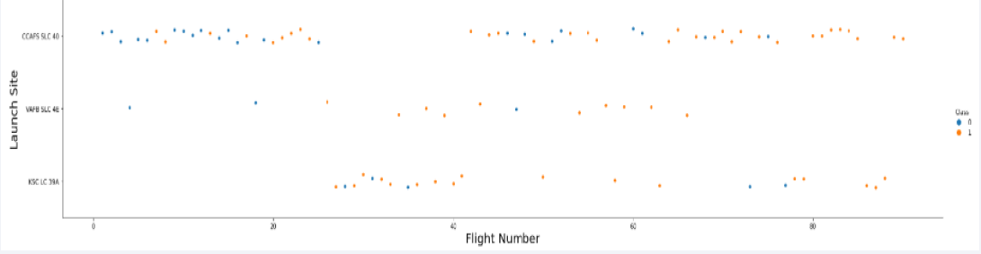
Flight Number vs. Launch Site
Based on the plot, it is evident that a higher number of flights at a launch site corresponds to a higher success rate at that site.

Slide 19
Payload vs. Launch Site
The success rate of the rocket increases with the greater payload mass for launch site CCAFS SLC 40."

Slide 20
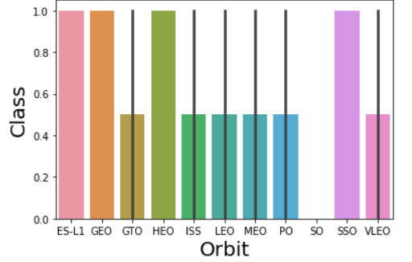
Success Rate vs. Orbit Type
In the plot, as we can see ES-L1, GEO, HEO, SSO, VLEO had the most success rate.

Slide 21
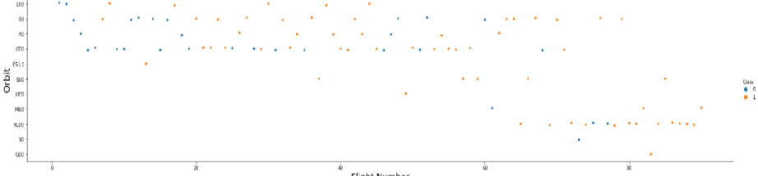
Flight Number vs. Orbit Type
The chart presented illustrates the correlation between Flight Number and Orbit type. It is noticeable that in the Low Earth Orbit (LEO), success appears to be associated with the number of flights, while in the Geostationary Transfer Orbit (GTO), there is no discernible relationship between flight number and the orbit."

Slide 22
Payload vs. Orbit Type
"It is evident that with heavier payloads, successful landings are more frequent for Polar Orbit (PO), Low Earth Orbit (LEO), and International Space Station (ISS) orbits."

Slide 23
Launch Success Yearly Trend
"According to the plot, the success rate has consistently increased from 2013 until 2020."

Slide 24
All Launch Site Names
"We utilized the keyword DISTINCT to display only unique launch sites from the SpaceX data."

Slide 25
Launch Site Names Begin with 'CCA'
"We employed the aforementioned query to showcase 5 records where launch sites begin with `"

Slide 26
Total Payload Mass
The query below enabled us to calculate that the total payload carried by boosters from NASA is 45596."

Slide 27
Average Payload Mass by F9 v1.1
The average payload mass carried by booster version F9 v1.1 was calculated to be 2928.4."

Slide 28
First Successful Ground Landing Date
"We noted that the first successful landing outcome on the ground pad occurred on December 22nd, 2015."

Slide 29
Successful Drone Ship Landing with Payload between 4000 and 6000
"We utilized the WHERE clause to filter for boosters that have successfully landed on the drone ship. Additionally, we applied the AND condition to identify successful landings with payload mass greater than 4000 but less than 6000."

Slide 30
Total Number of Successful and Failure Mission Outcomes
"We employed wildcards such as '%' to filter for cases where MissionOutcome was either a success or a failure using the WHERE clause."

Slide 31
Boosters Carried Maximum Payload
We identified the booster that carried the maximum payload by utilizing a subquery in the WHERE clause along with the MAX() function."

Slide 32
2015 Launch Records
"We employed a combination of the WHERE clause, LIKE, AND, and BETWEEN conditions to filter for failed landing outcomes on the drone ship, including their booster versions and launch site names, specifically for the year 2015."

Slide 33
Rank Landing Outcomes Between 2010-06-04 and 2017-03-20
We extracted Landing outcomes and the COUNT of landing outcomes from the data, utilizing the WHERE clause to filter for landing outcomes BETWEEN June 4, 2010, and March 20, 2010.
The GROUP BY clause was applied to group the landing outcomes, and the ORDER BY clause was used to arrange the grouped landing outcomes in descending order.

Slide 34

Section 3

Slide 35
Markers on the global map for all launch sites.

Slide 36
Markers indicating launch sites with color-coded labels.

Slide 37
Distance of launch sites to landmarks

Slide 38

Section 4

Slide 39
Pie chart illustrating the success percentage achieved by each launch site

Slide 40
Pie chart displaying the launch site with the highest launch success ratio

Slide 41
Scatter plot depicting Payload vs Launch Outcome for all sites, with various payload values selectable in the range slider

Slide 42

Section 5

Slide 43
Classification Accuracy
The decision tree classifier stands out as the model with the highest classification accuracy."

Slide 44
Confusion Matrix
"The confusion matrix for the decision tree classifier indicates its ability to distinguish between different classes. The primary issue lies in false positives, where unsuccessful landings are incorrectly marked as successful by the classifier."

Slide 45
Conclusions
In summary:
A higher number of flights at a launch site corresponds to a greater success rate.
The launch success rate has been on the rise from 2013 to 2020.
Orbits ES L1, GEO, HEO, SSO, VLEO exhibited the highest success rates.
KSC LC 39A recorded the most successful launches among all sites.
The Decision tree classifier emerged as the most effective machine learning algorithm for this task.

Slide 46
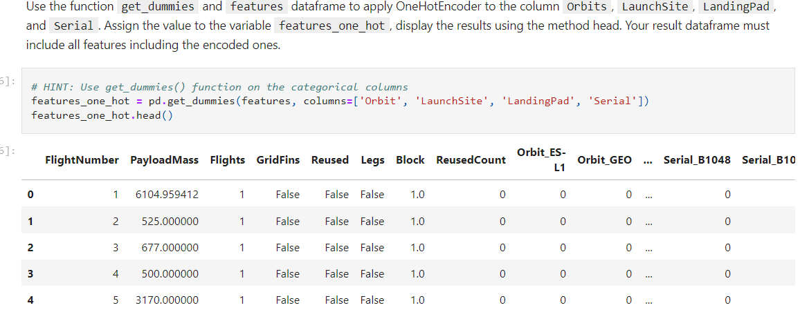
Appendix

Slide 47


